Slide 2
Presented by
Dr. Shahin Sharafeh

Slide 3
Overview
Introduction
Objective
Methodology
Defining ACLF
Predicting ACLF and Death
Management
Liver transplantation
Conclusions

Slide 5
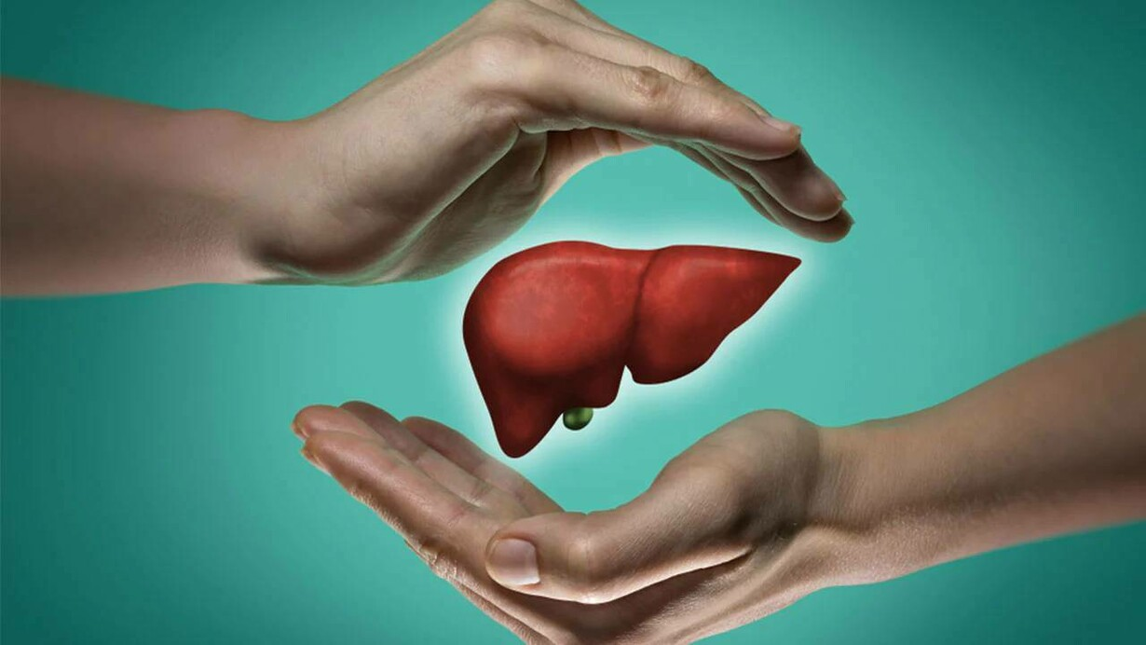
Introduction
Acute-on-chronic liver failure (ACLF), which was described relatively recently (2013), is a severe form of acutely decompensated cirrhosis characterized by the existence of organ system failure(s) and a high risk of short-term mortality.
ACLF is caused by an excessive systemic inflammatory response triggered by precipitants that are clinically apparent or not.
Acutely decompensated cirrhosis refers to the development of ascites, encephalopathy, gastrointestinal haemorrhage, or any combination of these disorders in patients with cirrhosis (Fig. 1).

Slide 6
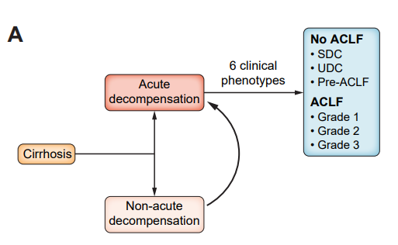
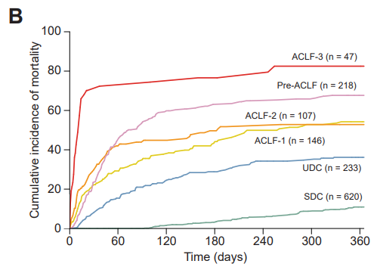

Slide 7
Introduction
ACLF is characterized by the functional failure of one or more of the six major organ systems (i.e., liver, kidney, brain, coagulation, circulation, and respiration; (Fig. 2), and systemic inflammation that may have been induced by acute precipitants.

Slide 8
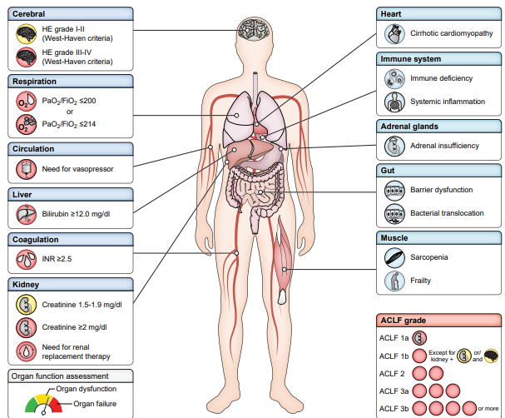

Slide 9
To provide recommendations to help clinicians recognize ACLF, make triage decisions (ICU vs. no ICU), identify and manage acute precipitants, identify organ systems that require support or replacement, define potential criteria for futility of intensive care, and identify potential indications for liver transplantation.
Based on an in-depth review of the relevant literature, we provide recommendations to navigate clinical dilemmas followed by supporting text.
The recommendations are graded according to the Oxford Centre for Evidence-Based Medicine system and categorized as ‘weak’ or ‘strong’.
We aim to provide the best available evidence to aid the clinical decision-making process in the management of patients with ACLF.

Slide 11
Methodology
The CPG panel drafted questions according to the PICO format. (P – Patient, problem, or population), (I – intervention), (C – Comparison, control or comparator), (O – Outcome).
PICO questions were vetted through a simplified Delphi process by a 38-member panel,
Every PICO question that did not reach >80% agreement in the first round of the Delphi process was revised; the revised questions were then submitted for approval by the Delphi panelists in a second round.
Once the final PICO questions had been determined, a systematic literature search was performed using PubMed, and expanding to Embase, Google Scholar and Scopus when needed.
The panel met virtually on 10 occasions, and all recommendations were discussed and approved by all participants.
The level of evidence was graded according to the Oxford Centre for Evidence-Based Medicine system (Table 1) and the strength of the recommendations was categorized as either ‘weak’ or ‘strong’ (Table 2).

Slide 12
Methodology

Slide 14
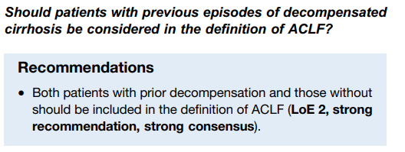
Defining ACLF

Slide 15
Defining ACLF

Slide 16
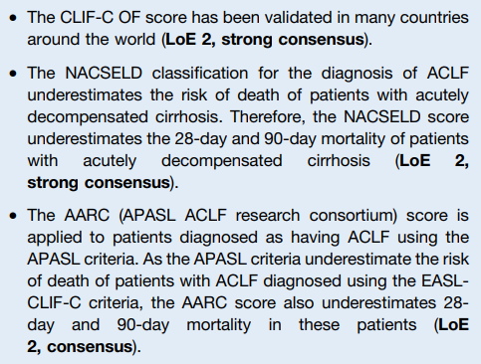
Defining ACLF

Slide 17
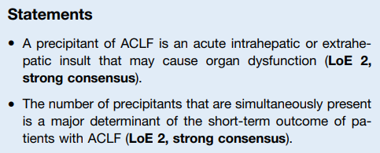
Defining ACLF

Slide 18
Defining ACLF

Slide 19
Defining ACLF

Slide 20
Defining ACLF

Slide 21
Defining ACLF

Slide 23
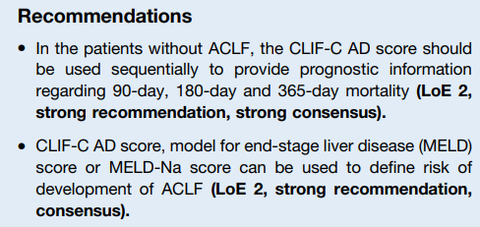
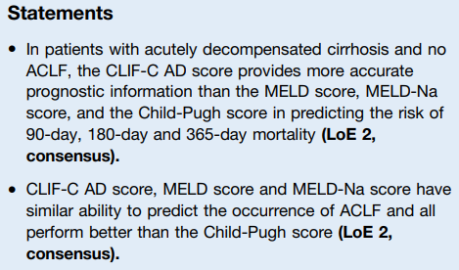
Predicting ACLF and Death
Is the CLIF-C acute decompensation (AD) score more accurate than other prognostic scores in predicting risk of development of liver-related complications, ACLF and 90- day transplantation-free mortality in patients without ACLF?

Slide 24
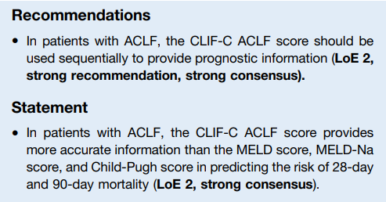
Predicting ACLF and Death
Is the CLIF-C ACLF score more accurate than other prognostic models for patients with ACLF?

Slide 26
Management

Slide 27
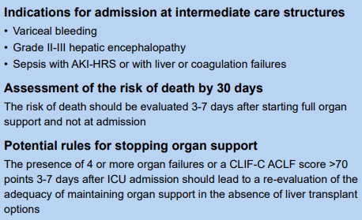
Management

Slide 28
Management

Slide 29
Management

Slide 30
Management

Slide 31
Management

Slide 32
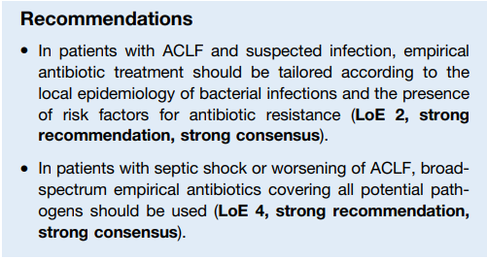
Management
Bacterial and fungal infections
Do empirical antibiotic strategies tailored to the severity of infection and local epidemiology impact on the outcome of patients with ACLF?

Slide 33
Management

Slide 34
Management

Slide 35
Management

Slide 36
Management

Slide 37
Management

Slide 38
Management

Slide 39
Management

Slide 41
Liver Transplantation

Slide 42
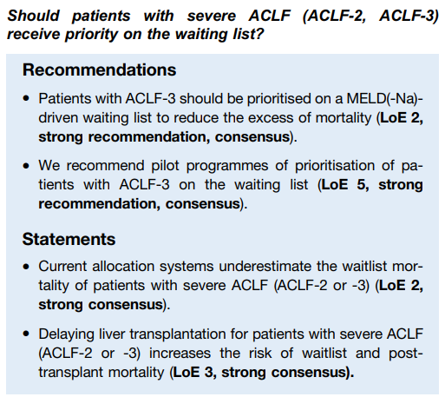
Liver Transplantation

Slide 43
Liver Transplantation

Slide 44
Liver Transplantation

Slide 45
Liver Transplantation

Slide 47
Conclusion
ACLF is now recognized as a distinct clinical entity associated with a high risk of short-term death.
The main principle for the management of ACLF is to diagnose and treat acute precipitants and provide organ support.
Three questions should be urgently addressed in the field:
First, the mechanisms of systemic inflammation, which is the driver of ACLF, should be investigated to identify targets for novel therapeutic approaches, in particular for patients who develop ACLF without any clinically apparent precipitant.
Second, most of our knowledge on the management of patients with ACLF is based on studies involving critically ill patients without cirrhosis. Therefore, interventions for which clinical equipoise exists in patients with ACLF should be identified in order to design useful randomized-controlled trials.
Third, studies should address the difficult question of criteria to define futility of liver transplantation in patients with ACLF-3, as robust criteria would impact the medical management of these patients.

Slide 49
Resourses
[1] D’Amico G, Bernardi M, Angeli P. Towards a new definition of decompensated cirrhosis. J Hepatol 2022 Jan;76(1):202–207.
[2] Moreau R, Jalan R, Gines P, Pavesi M, Angeli P, Cordoba J, et al. Acute-onChronic liver failure is a distinct syndrome that develops in patients with acute decompensation of cirrhosis. Gastroenterology 2013 Jun;144(7): 1426–1437.e9.
[3] Trebicka J, Fernandez J, Papp M, Caraceni P, Laleman W, Gambino C, et al. PREDICT identifies precipitating events associated with the clinical course of acutely decompensated cirrhosis. J Hepatol 2021 May 1;74(5):1097–1108.
[4] Arroyo V, Moreau R, Jalan R. Acute-on-Chronic liver failure. N Engl J Med 2020 May 28;382(22)
[5] Moreau R, Gao B, Papp M, Bañares R, Kamath PS. Acute-on-chronic liver failure: a distinct clinical syndrome. J Hepatol 2021 Jul;
[6] Sarin SK, Choudhury A, Sharma MK, Maiwall R, al Mahtab M, Rahman S, et al. Acute-on-chronic liver failure: consensus recommendations of the Asian Pacific association for the study of the liver (APASL): an update. Hepatol Int 2019 Jul
[7] Bajaj JS, O’Leary JG, Reddy KR, Wong F, Biggins SW, Patton H, et al. Survival in infection-related acute-on-chronic liver failure is defined by extrahepatic organ failures. Hepatology 2014;60(1):250–256.
[8] Durand F, Roux O, Weiss E, Francoz C. Acute-on-chronic liver failure: where do we stand? Liver Int 2021 Jun 1;41(S1):128–136.

Slide 50
Resourses
9. Zaccherini G, Weiss E, Moreau R. Acute-on-chronic liver failure: definitions, pathophysiology and principles of treatment. JHEP Rep 2021 Feb;3(1):100176..
.
.
[190] Duan BW, Lu SC, Wang ML, Liu JN, Chi P, Lai W, et al. Liver transplantation in acute-on-chronic liver failure patients with high model for end-stage liver disease (MELD) scores: a single center experience of 100 consecutive cases. J Surg Res 2013 Aug;183(2):936–943.
[191] Toshima T, Harada N, Itoh S, Morita K, Nagao Y, Kurihara T, et al. Outcomes of living-donor liver transplantation for acute-on-chronic liver failure based on newly proposed criteria in Japan. Clin Transpl 2022 Aug;36(8):e14739.
[192] Yadav SK, Saraf N, Choudhary NS, Sah JK, Sah SK, Rastogi A, et al. Living donor liver transplantation for acute-on-chronic liver failure. Liver Transplant 2019 Mar 1;25(3):459–468.
[193] Moon DB, Lee SG, Kang WH, Song GW, Jung DH, Park GC, et al. Adult living donor liver transplantation for acute-on-chronic liver failure in high– model for end-stage liver disease score patients. Am J Transplant 2017 Jul 1;17(7):1833–1842.
[194] Jalan R, D’Amico G, Trebicka J, Moreau R, Angeli P, Arroyo V. New clinical and pathophysiological perspectives defining the trajectory of cirrhosis. J Hepatol 2021 Jul;75(Suppl 1):S14–S26.
[195] Shi Y, Yang Y, Hu Y, Wu W, Yang Q, Zheng M, et al. Acute-on-chronic liver failure precipitated by hepatic injury is distinct from that precipitated by extrahepatic insults. Hepatology 2015 Jul;62(1):232–242.

